Slide 1

Annual Report
AGM November 2012

Slide 2
BTHC Strengths seen in 2012
Brilliant Archie Roach Sorry Day Concert
Extensive Support for NSGA (Jim, Keith, Ian)
City Banners displayed Reconciliation Week with support from City of Perth and DIA
Red Dust Healing workshops, Anglicare
Advocating for a new Reconciliation WA
Input to Reconciliation Action Plans, and all new school chaplains
Financially sound
Increased Corporate support and Relationships with Anglicare, Noongar Radio, Rotary , Mogumber Advisory Committee, Roelands, Sister Kates, Mental health and well being network, Congress, Uniting Justice, ECU and UWA
Consistent volunteer roll-up
High energy for the goals of BTH

Slide 3
NSGA Strengths seen in 2012
Survived internal conflicts
Increase in number of affiliates
Parliamentary Seminar in Canberra with tertiary ed sector
Canberra and Adelaide Forums
Policy and Procedures defined
New staff appointed
Financially sound
Ongoing Relationships and Communication with FACHSIA, OATSIH, Caritas
High energy for the goals
Constitution amendments
Held annual forum Alice Springs 2011, and plans in place for Perth 2012

Slide 4
Main Roles of BTHC in Truth Justice and Healing for Stolen Generations
An advocacy and leadership role
Awareness creation
Supporting
  stolen generation people and their families
  healing and justice programs
Networking and partnerships
Providing direction to Reconciliation WA

Slide 5
BTHC Weaknesses 2012
Exhausting for Jim in NSGA. Stepping down in December.
Stolen generation people
  Lack of clarity on definition of stolen generation
  Not enough interaction with stolen gen people
  Dropped off from holding Yarning Circles
No WA state-wide network
Do things ‘last minute’. Not proper consultation. Reliance on a few members and not empowering others. No time for friendship-yarning

Slide 6
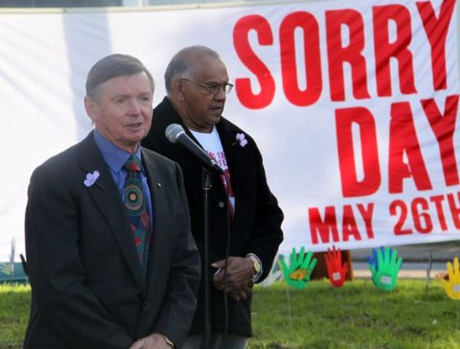
Highlights in pictures!

Slide 7
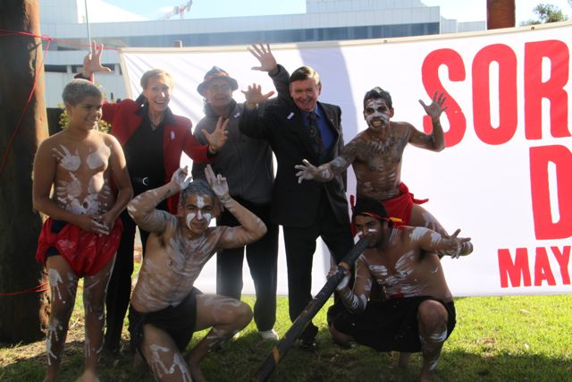
Highlights (continued)

Slide 8
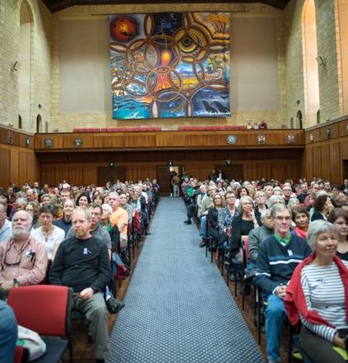
Highlights (continued)

Slide 9
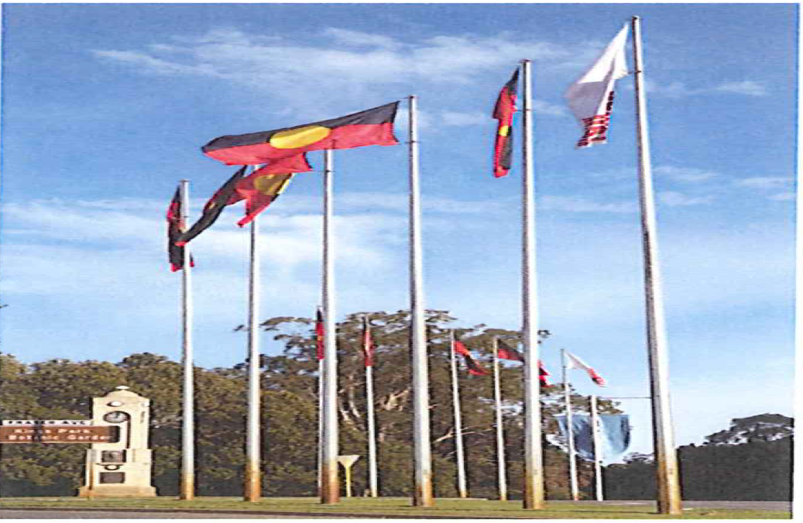
Highlights (continued)

Slide 10
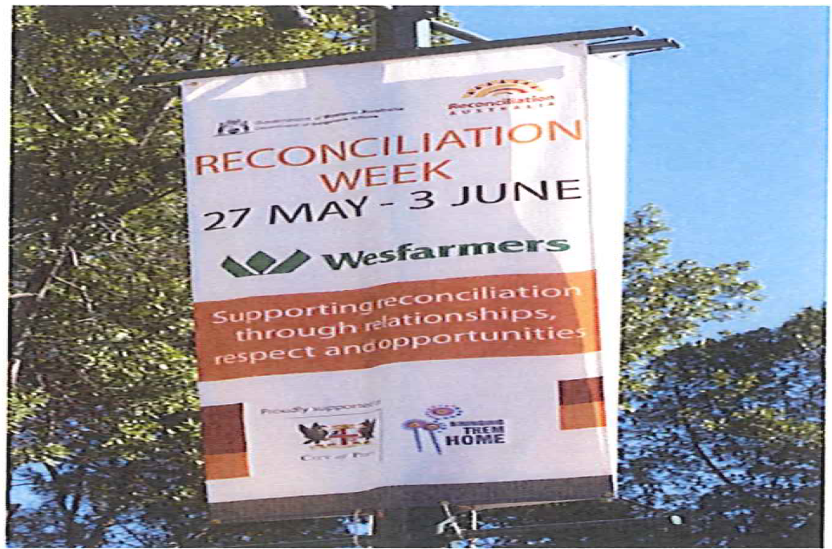
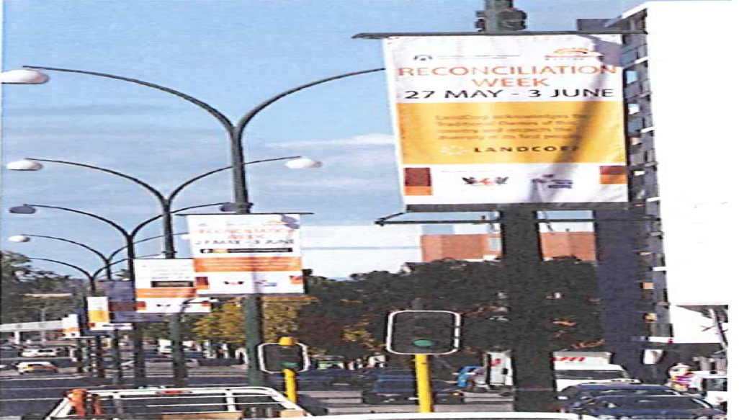
Highlights (Continued)

Slide 11
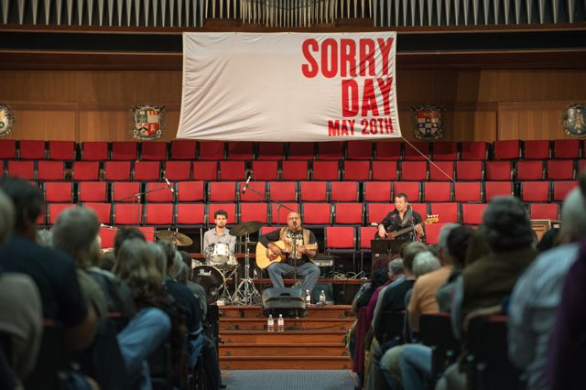
Highlights (continued)

Slide 12
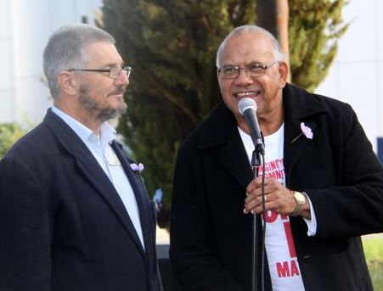
Highlights (continued)

Slide 13
What are we going to do about it?
Action
More time for yarning Every second monthly meeting add on to the meeting a discussion on one of: Truth Justice Healing; or A meeting with stolen generation people Run a Saturday morning meeting every 3 months, 9am – midday
Engage with Mogumber and Roelands Invite conveners and members to the NSGA forum

Slide 14
Actions
Action
Healing programs Approach Yorgum about the Marumali program
Stolen generation memorial / museum Museum Arrange meeting with museum CEO. Memorial Arrange meeting with Committee for Perth (Marion Falkner)

Slide 15
Actions
Action
Curfew line Approach the Town of Vincent about possible recognition of the ‘curfew line’
Funding Review Constitution with regard our DGR status
Sorry Day Approach Lotterywest about funding, goalposts have moved
ECU Lecture This will be held on the anniversary of the Apology (15th February)

Slide 16
Yet More Burning Ideas- who will step up?
More ‘bite’ to our healing work. Healing Centre's?
How do we get people involved? What is a pathway for this?
Build on Red Dust - Program for women
Telling and recording the stories – Need structures and partnerships e.g. Yirra Yarkin

Slide 17
Thanks
To all volunteers on BTH Committee : Jim, Ian, Alan, Laura, Mary, Irene, Ross, Andrew, Keith, Damien, Levon, Bev, Sarah and Wendy.
Behind the scenes and the wider network
To corporate donors
To personal donors and supporters

